Slide 1



House Price Prediction
Capstone Project
By Sushma R
USN:231VMBR04860

Slide 2
Objective
To develop a machine learning–based predictive model that accurately estimates house prices in King County, Washington, using real estate features such as location, living area, quality and amenities.
Build an accurate prediction model that estimates residential property prices using key housing attributes.
Analyse data patterns through Exploratory Data Analysis (EDA) to identify major factors influencing house prices.
Compare multiple regression and ensemble models (Linear, Ridge, XGBoost, LightGBM, CatBoost) to select the most efficient one.
Improve decision-making for buyers, sellers, and investors by providing data-driven insights into property valuation.
Deploy a scalable and interpretable model that can be adapted for other regions or real-estate markets.

Slide 3
Project Methodology
Problem Definition & Objective Setting
Defined the goal: Predict house prices in King County using machine learning.
Identified target users – buyers, sellers, and real-estate professionals.
Data Cleaning & Preprocessing
Treated missing values using median/mode imputation.
Removed outliers (97th percentile winsorization).
Applied feature engineering (Age, Age Bucket, Basement Flag, Sold Year/Month).
Encoded categorical variables and scaled numerical data.
Exploratory Data Analysis (EDA)
Univariate, bivariate, and multivariate analysis performed.
Identified key predictors: Living area, Quality, Location, and Coastal Proximity.
Visualized insights using histograms, scatter plots, and correlation heatmaps.

Slide 4
Project Methodology
Model Building
Implemented multiple algorithms: Linear Regression, Ridge, Decision Tree, XGBoost, LightGBM, and CatBoost.
Used 80:20 train-test split and 5-fold cross-validation.
Model Evaluation & Selection
Metrics: R², Adjusted R², RMSE, MAE.
CatBoost Regressor achieved best accuracy (R² = 0.90, RMSE ≈ ₹75K).
Business Insights & Recommendations
Derived top factors influencing property value.
Proposed data-driven pricing and investment strategies.

Slide 5
Project Methodology
Model Deployment (Future Scope)
Can be deployed as an interactive dashboard or web-based valuation tool.
Tools :
Programming & Analysis: Python (Pandas, NumPy, Scikit-learn)
Visualization: Matplotlib, Seaborn
Modeling: Linear Regression, Ridge, Decision Tree, XGBoost, LightGBM, CatBoost
Environment: Jupyter Notebook, Google Colab
Data Handling: Excel & CSV Files
Version Control: GitHub / Google Drive

Slide 6
Project Methodology
Materials
Source: King County Housing Dataset
Size: 21,613 records, 21 features
Key Attributes: Bedrooms, Bathrooms, Living Area, Lot Size, Location, Year Built, Condition, Quality, Furnishing, Price
Data Type: Structured (Tabular)
Objective: Predict house prices using property characteristics and location-based factors

Slide 7
Project Methodology
Process
Conducted Exploratory Data Analysis (EDA) to understand variable relationships using visual (heatmaps, scatter plots) and statistical techniques.
Applied data cleaning and preprocessing, including handling of missing values, outlier removal (97th percentile winsorization), and feature engineering (Age, Age Bucket, Basement Flag).
Performed log transformation and normalization to reduce skewness and improve model performance.
Evaluated feature correlations to remove redundancy and improve model efficiency.
Selected multiple regression and ensemble models for comparison: Linear Regression, Ridge, Decision Tree, XGBoost, LightGBM, and CatBoost.

Slide 8
Project Methodology
Implementation
Split the dataset into training (80%) and testing (20%) subsets.
Trained models using cross-validation and optimized hyperparameters for best performance.
Evaluated models with R², Adjusted R², RMSE, and MAE metrics.
CatBoost Regressor delivered the highest predictive accuracy (R² = 0.90, RMSE ≈ ₹75K).
Generated business insights from the best model to identify key price drivers such as living area, quality, and location.
Proposed real-time deployment potential through a web-based valuation dashboard for property stakeholders.

Slide 9
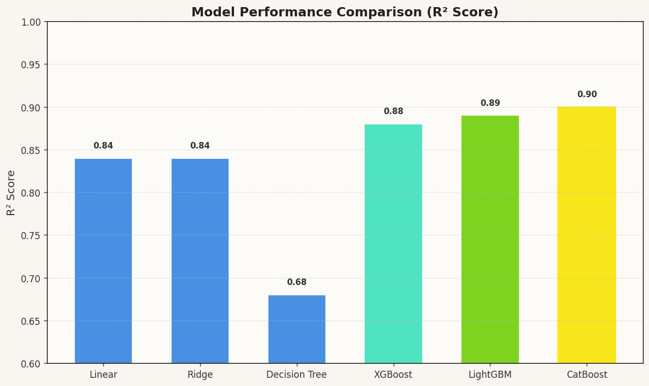
Result
CatBoost Regressor achieved the highest accuracy (R² = 0.90) and the lowest RMSE (~75,000).
LightGBM and XGBoost also performed strongly, confirming that ensemble models outperform linear ones.
Performance Insights
Linear & Ridge Regression: Provided strong baseline accuracy (R² = 0.84).
Decision Tree: Captured non-linear relationships but overfitted (R² = 0.68).
CatBoost: Balanced bias and variance, giving the most stable predictions.

Slide 10
Analysis
Exploratory Data Analysis (EDA)
Conducted Univariate, Bivariate, and Multivariate analysis to identify key relationships between features and house prices.
Found strong positive correlations between Price and features like Living Area, Quality, and Location (Latitude).
Applied log transformation on skewed variables (like living area) to improve normality and model performance.
Business Insights
Houses with larger living area, higher quality, and coastal locations command significantly higher prices.
Older properties tend to have slightly lower prices unless located in premium neighborhoods.
Furnished homes and those in better condition showed clear value appreciation.

Slide 11
Outcome
The CatBoost Regressor emerged as the most accurate model with an R² Score of 0.90 and the lowest RMSE of ~75,000, outperforming all other regression techniques.
The analysis revealed that living area, house quality and location are the most influential factors in determining property prices in King County.
The model offers a data-driven pricing framework that can assist buyers, sellers, and real-estate professionals in making fair and transparent pricing decisions.
This project establishes a scalable predictive solution that can be extended to other regions, supporting market analysis, investment strategies and urban development planning.

Slide 12
Learning Aspect
Gained a comprehensive understanding of the end-to-end data science workflow — from data cleaning, feature engineering and visualization to model training and evaluation.
Learned to apply machine learning regression techniques such as Linear Regression, Decision Tree, XGBoost, LightGBM, and CatBoost and understood how to interpret their performance metrics.
Improved ability to perform Exploratory Data Analysis (EDA) using Python libraries like Pandas, Matplotlib, and Seaborn to derive actionable business insights from raw data.
Understood the importance of model validation, bias-variance tradeoff and hyperparameter tuning in improving model accuracy and generalisation.
Enhanced practical knowledge in translating analytical outcomes into business insights, strengthening decision-making skills applicable in real-world scenarios.

Slide 13
Conclusion
The study successfully developed a machine learning-based house price prediction model using real-world data from King County, Washington.
Among all tested models, CatBoost Regressor achieved the highest prediction accuracy (R² = 0.90) and the lowest RMSE (~75,000), proving to be the most reliable and stable model.
The research identified that living area, house quality and location are the most critical factors driving property prices.
The model offers a data-driven approach to real-estate valuation, promoting pricing transparency, better investment decisions, and market efficiency.

Slide 14
Thank You

